Slide 1
Distribution of Sample Mean, proportion,
and variance

Slide 2
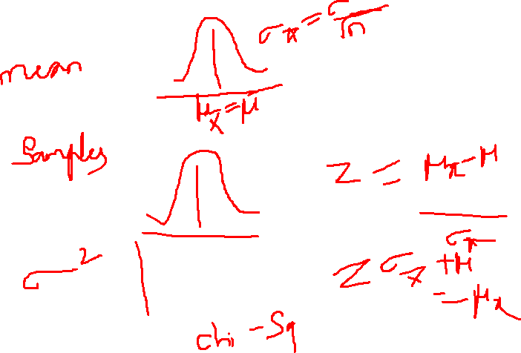

Slide 3
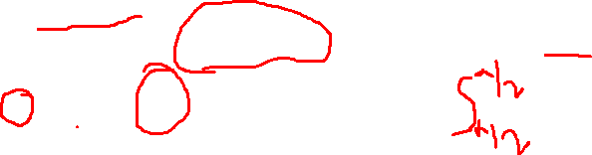
Acceptance Intervals
Goal: determine a range within which sample means are likely to occur, given a population mean and variance
By the Central Limit Theorem, we know that the distribution of X is approximately normal if n is large enough, with mean μ and standard deviation
Let z_{α/2} be the z-value that leaves area α/2 in the upper tail of the normal distribution (i.e., the interval - z_{α/2} to z_{α/2} encloses probability 1– α)
Then
μ± z_{α/2}σ_{X}
is the interval that includes X with probability 1 – α

Slide 4
Sampling Distributions of Sample Proportions
Sampling Distributions
Sampling Distribution of Sample
Mean
Sampling Distribution of Sample Proportion
Sampling Distribution of Sample Variance

Slide 5

Sampling Distributions of Sample Proportions
P = the proportion of the population having some characteristic
Sample proportion (p^{ˆ}) provides an estimate of P:
_{pˆ =} X ₌ number of items in the sample having the characteristic of interest n sample size
0 ≤ _{pˆ} ≤ 1
pˆ
has a binomial distribution, but can be approximated by a normal
distribution when nP(1 – P) > 5

Slide 6
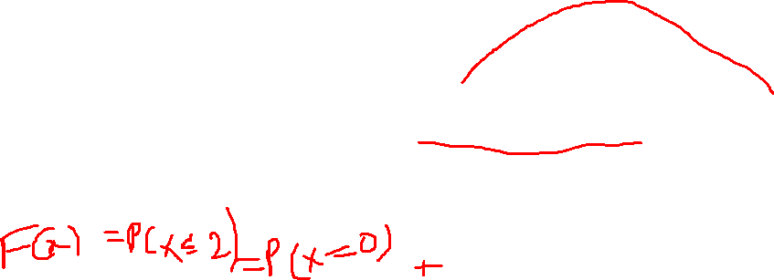
Sampling Distribution of p^
Normal approximation:
Sampling Distribution
P(P^{ˆ} )
.3
.2
.1
0
Properties:
E(pˆ) = P
0 . 2 .4 .6
8 1
(where P = population proportion)
And
_{σ2 = Var}⎛ X ⎞ ₌ P(1− P)
⎜ _{n} ⎟
pˆ
⎝ ⎠
n

Slide 7
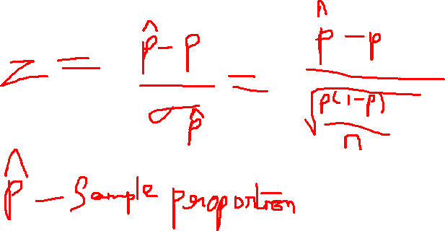

Slide 8

Z-Value for Proportions
Standardize p^{ˆ} to a Z value with the formula:
_{Z =} pˆ −P ₌ pˆ −P σ_{pˆ} P(1− P)
n

Slide 9

Example
If the true proportion of voters who support Proposition A is P = .4, what is the probability that a sample of size 200 yields a sample proportion between .40 and .45?
i.e.:
if P = .4 and n = 200, what is
P(.40 ≤ pˆ ≤ .45) ?

Slide 10
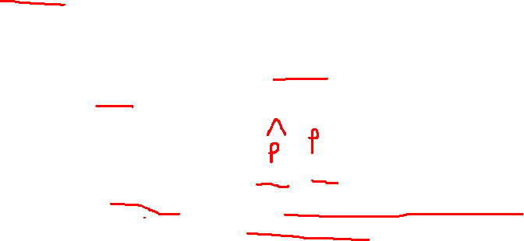
Example
(continued)
if P = .4 and n = 200, what is
P(.40 ≤ pˆ ≤ .45) ?
P(1− P) ₌ .4(1−.4) _{= .03464} n 200
Find: σ _{ˆ}
σ =
p
pˆ
Convert to standard normal:
P(.40 ≤ pˆ ≤ .45) = P^{⎛.40 −.40} ≤ Z ≤ ^{.45 −.40 ⎞}
⎝
= P(0 ≤ Z ≤ 1.44)
⎜ .03464 .03464 ⎟
⎠

Slide 11

Example
(continued)
if P = .4 and n = 200, what is P(.40 ≤ pˆ ≤ .45) ?
P(0 ≤ Z ≤ 1.44) = .4251
Standardized
Normal Distribution
Use standard normal table:
Sampling Distribution
.4251
Standardize
.40
.45
pˆ
0
1.44
Z

Slide 12
Sampling Distributions of Sample Variance
Sampling Distributions
Sampling Distribution of Sample
Mean
Sampling Distribution of Sample Proportion
Sampling Distribution of Sample Variance

Slide 13
Sample Variance
Let x₁, x₂, . . . , x_{n} be a random sample from a population. The sample variance is
_{s2 =} 1 ∑
n
(x − x)²
n −1
i
i=1
the square root of the sample variance is called the sample
standard deviation
the sample variance is different for different random samples from the same population

Slide 14
Sampling Distribution of Sample Variances
The sampling distribution of s² has mean σ²
E(s² ) = σ²
If the population distribution is normal then
(n-1)s²
_{σ}2
has a χ² distribution with n – 1 degrees of freedom

Slide 16

The Chi-square Distribution
The chi-square distribution is a family of distributions, depending on degrees of freedom: d.f. = n – 1
_{χ}2
_{χ}2
_{χ}2
0 4 8 12 16 20 24 28
0 4 8 12 16 20 24 28
0 4 8 12 16 20 24 28

Slide 17
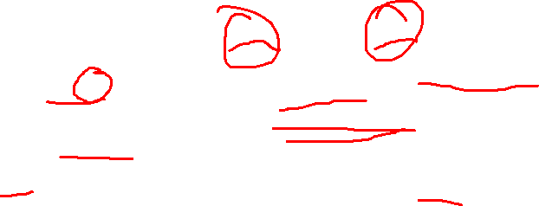
Degrees of Freedom (df)
Idea: Number of observations that are free to vary after sample mean has been calculated
Example: Suppose the mean of 3 numbers is 8.0
Let X₁ = 7
Let X₂ = 8
What is X₃?
If the mean of these three values is 8.0, then X₃ must be 9
(i.e., X₃ is not free to vary)
Here, n = 3, so degrees of freedom = n – 1 = 3 – 1 = 2
(2 values can be any numbers, but the third is not free to vary for a given mean)

Slide 18
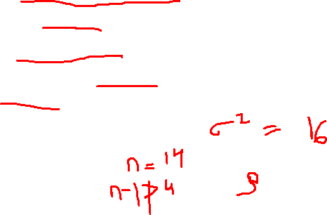
Chi-square Example
A commercial freezer must hold a selected temperature with little variation. Specifications call for a standard deviation of no more than 4 degrees (a variance of 16 degrees²).
A sample of 14 freezers is to be tested
What is the upper limit (K) for the sample variance such that the probability of exceeding this limit, given that the population standard deviation is 4, is less than 0.05?

Slide 19
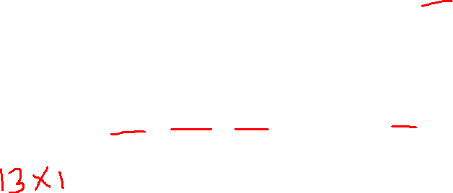
Finding the Chi-square Value
(n−1)s² _{σ}2
2
Is chi-square distributed with (n – 1) = 13
degrees of freedom
χ =
Use the the chi-square distribution with area 0.05 in the
upper tail:
χ²13 = 22.36 (α = .05 and 14 – 1 = 13 d.f.)
probability α = .05
_{χ}2
^{χ2}13
= 22.36

Slide 20
Chi-square Example
(continued)
_{χ}2
13
= 22.36 (α = .05 and 14 – 1 = 13 d.f.)
⎛ (n −1)s² ⎞
2
2
So:
P(s > K) = P⎜ > χ ⎟ = 0.05
⎝
16
13
⎠
(n −1)K _{= 22.36} 16
or
(where n = 14)
_{K =} (22.36)(16) _{= 27.52}
so
(14 −1)
If s² from the sample of size n = 14 is greater than 27.52, there is strong evidence to suggest the population variance exceeds 16.

Slide 21
Summary
Introduced sampling distributions
Described the sampling distribution of sample means
For normal populations
Using the Central Limit Theorem
Described the sampling distribution of sample proportions
Introduced the chi-square distribution
Examined sampling distributions for sample variances
Calculated probabilities using sampling distributions

Slide 22
Thank You

